Slide 1
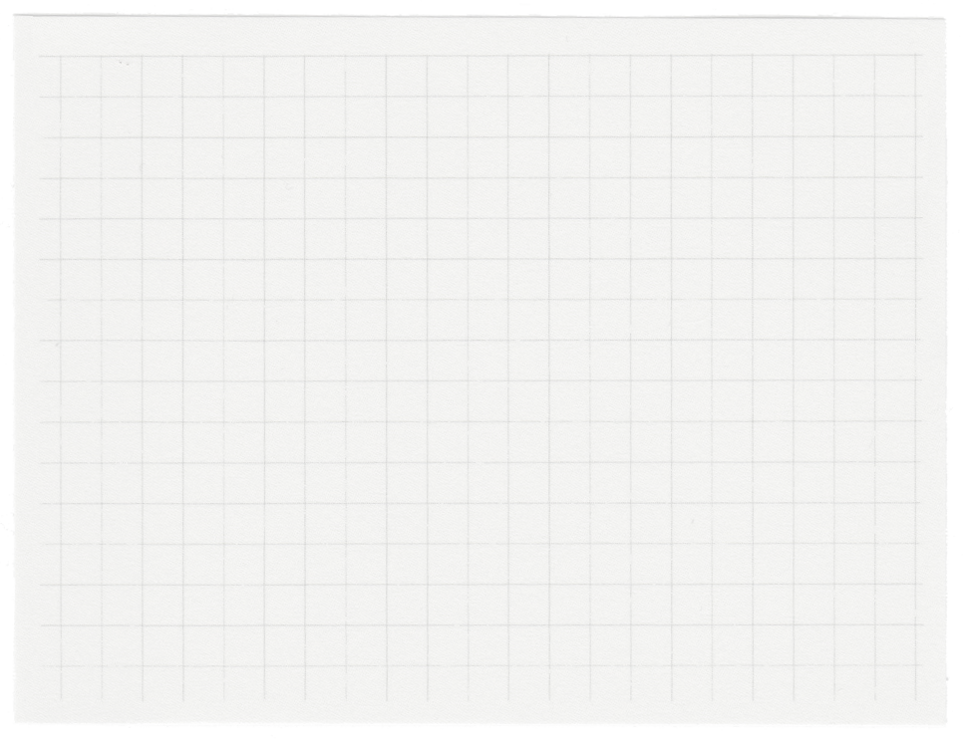













Project Presentation
Presented by Prabhu Pritam

Slide 2



Let’s Get Started
Introduction
Objective & Scope Of the Project
Application Tools
Project Design
Flowchart
Testing And Validation
Conclusion
Limitaitons
References

Slide 3
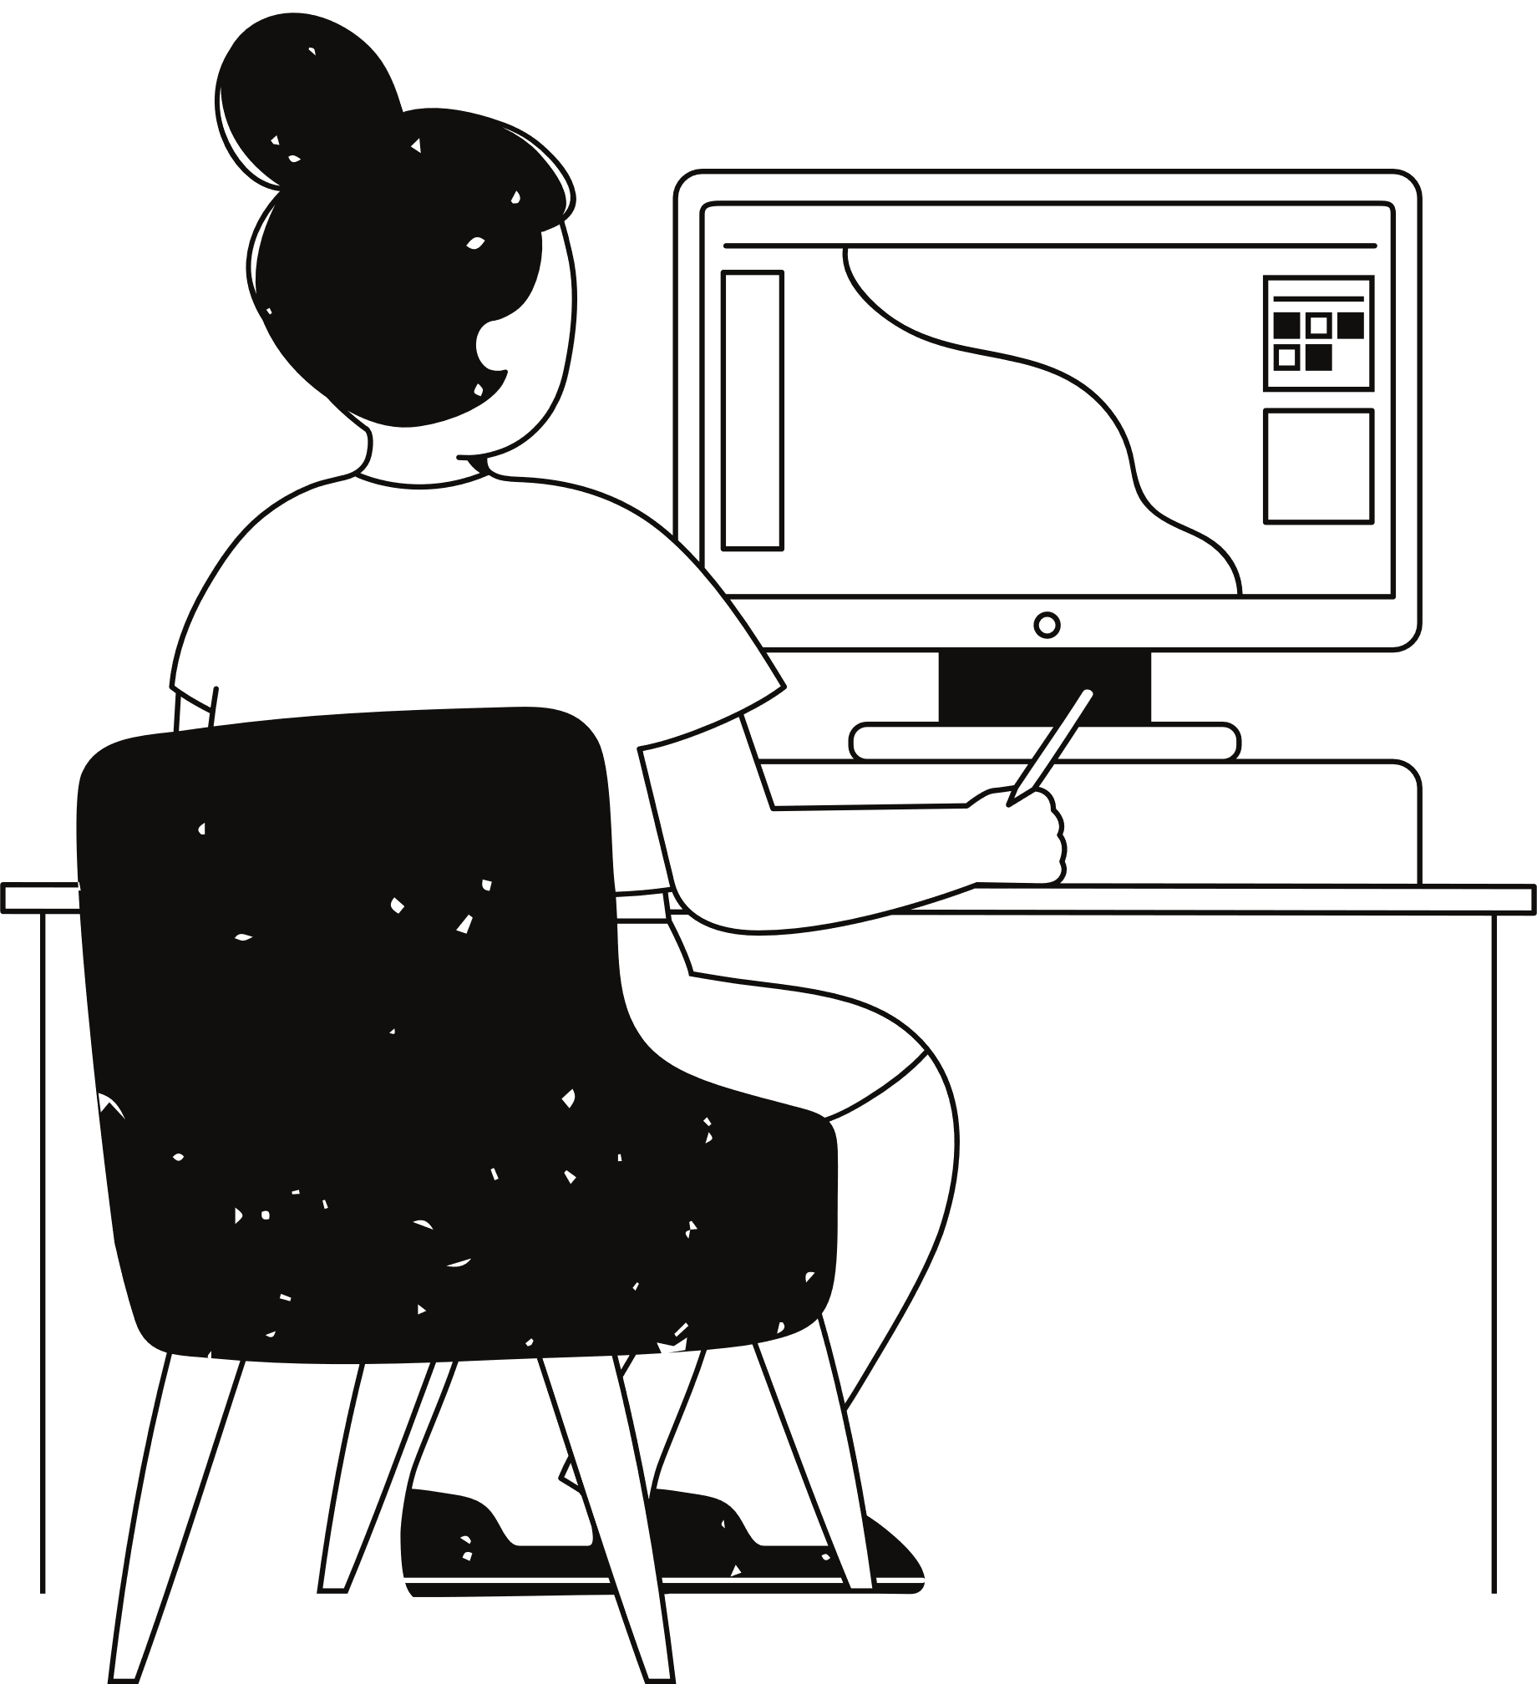
Introduction
This project involves a Retailer Inventory System using Python. The system features a graphical user interface (GUI) built with the Tkinter module and utilizes SQLite for database management. The primary objective is to create an efficient and user-friendly inventory management solution for retailers.
The system includes functionalities such as user authentication, item management (add, delete, search), and bill generation. By combining a robust backend with an intuitive frontend, this project aims to streamline inventory processes for small to medium-sized retail businesses.

Slide 4
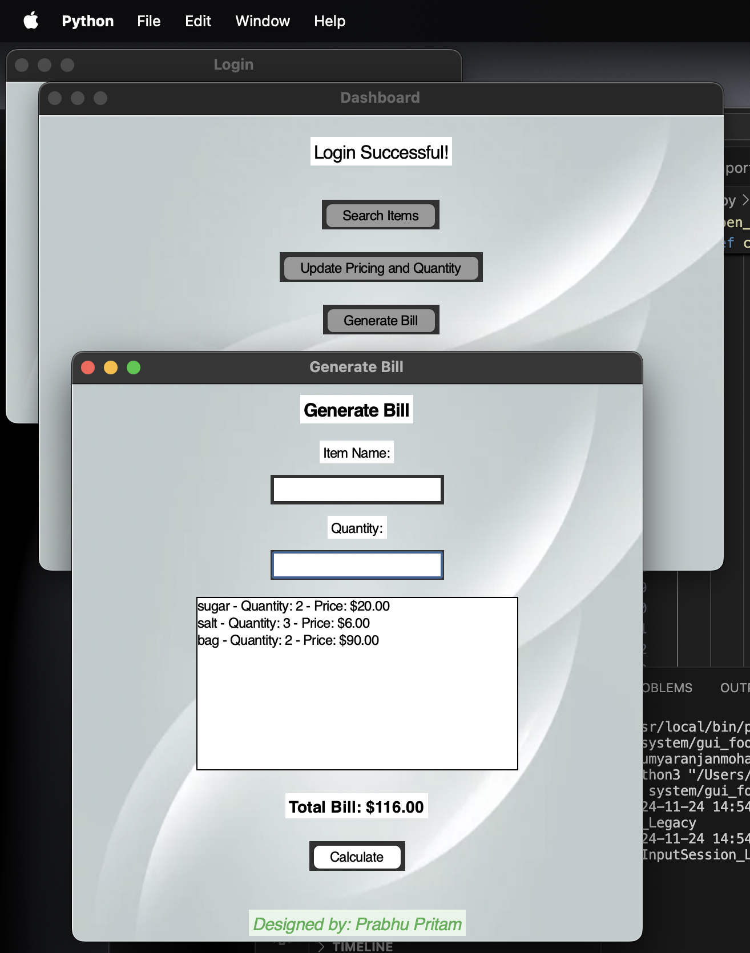
Objective Of The Project
Authentication:
Implement a secure login system using SQLite to restrict unauthorized access and protect sensitive data.
Inventory Management:
Enable users to efficiently add new items and update pricing and quantities with a simple graphical interface.
Billing System:
Provide an interactive platform for generating bills by dynamically calculating the total based on user input, reducing errors and improving transaction efficiency.
User Experience:
Design a Tkinter-based GUI that is intuitive and accessible, ensuring ease of use for both technical and non-technical users.
Scalability:
Develop a modular system that can be expanded in the future to include features like reports, data analytics, or cloud integration for broader usability.

Slide 5

Scope Of the Project
This project aims to provide a basic yet functional inventory and billing management system using Python’s Tkinter library for the graphical user interface (GUI) and SQLite for database management. The scope of this project includes the following key features and functionalities:
User Authentication: Secure login mechanism using an SQLite database to validate user credentials. Restricts access to authorized users, protecting sensitive data and ensuring system integrity.
Inventory Management: Add new items to the inventory, including their name, price, and quantity. Update existing items' pricing and quantities as needed. Create a modular system capable of accommodating additional inventory-related features in the future.
Billing System: Generate bills dynamically by allowing users to input item details such as name, quantity, and price. Calculate and display the total amount for all items added to the bill. Provide a list of added items, enabling users to verify and manage transaction details before finalizing.
User-Friendly Interface: Design a Tkinter-based GUI with clear labels, input fields, buttons, and feedback mechanisms. Ensure the interface is intuitive for users with minimal technical knowledge.
Real-Time Feedback and Error Handling: Display error messages for invalid inputs (e.g., incorrect quantities or pricing formats). Provide success or failure feedback for login and system operations.
Modular Design for Future Expansion: Include a foundational framework that can be expanded with additional features, such as generating sales reports, integration with external databases or cloud-based systems, or advanced security options like password encryption or multi-factor authentication.

Slide 6
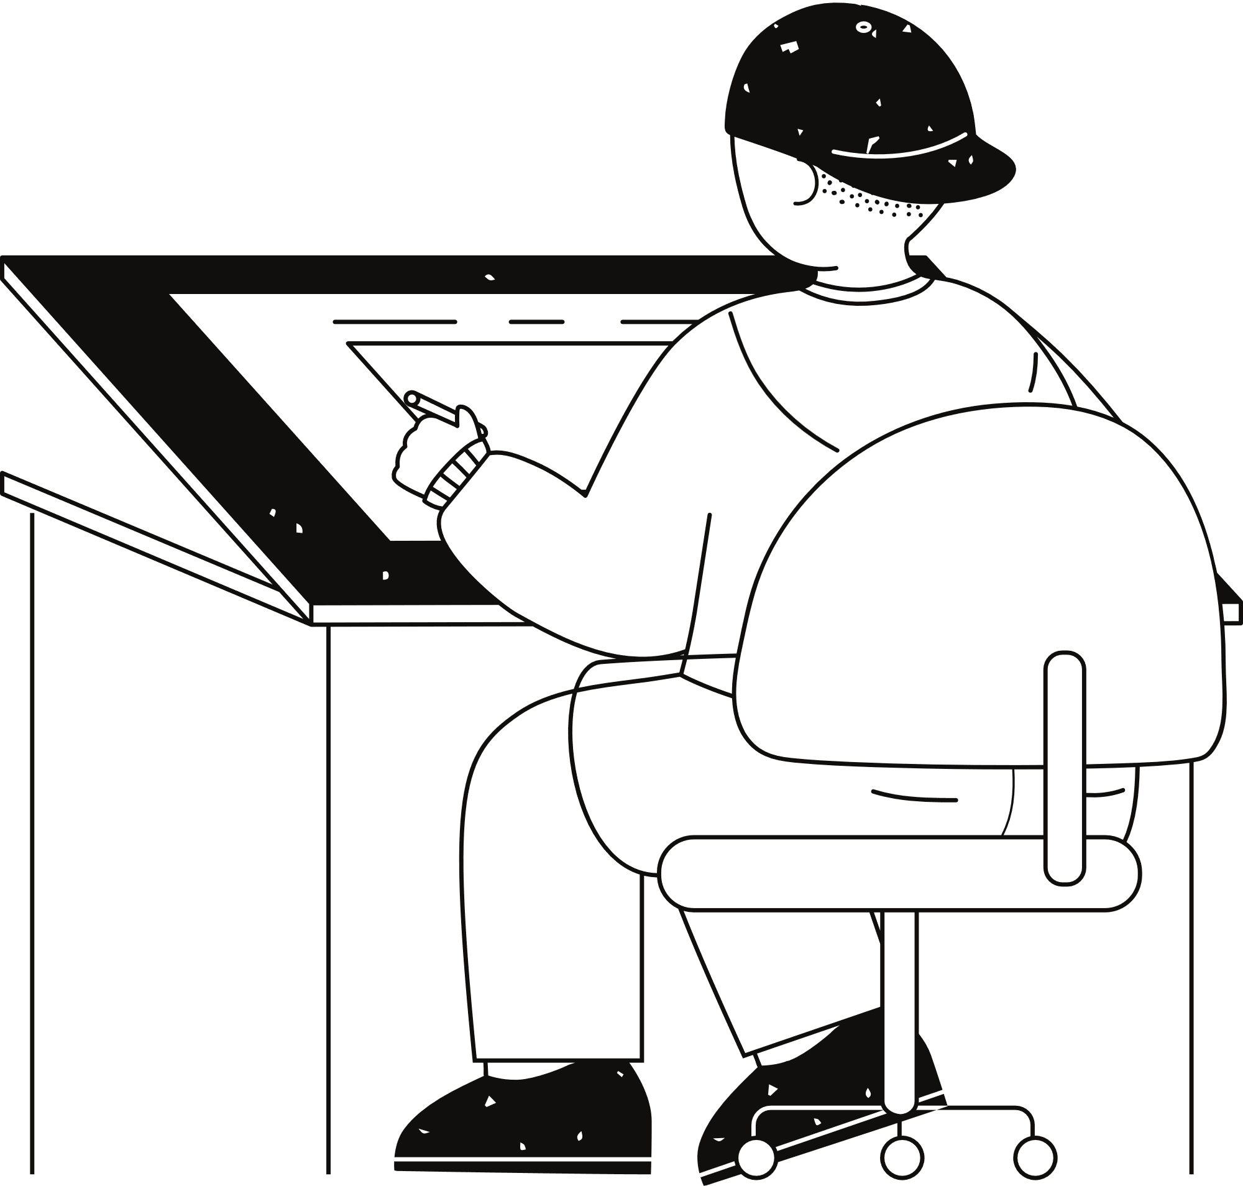






DB Management System:
SQLite:
A lightweight, file-based relational database management system for securely storing and retrieving user credentials. It is ideal for small to medium-scale applications, eliminating the need for external database servers.
Programming Language
Python:
The core programming language used for developing the application due to its simplicity, versatility, and extensive library support.
Python Libraries & Modules:
sqlite3: A Python module for connecting with the SQLite database. It enables database operations.
messagebox: A Tkinter submodule used to display error, warning, or information messages to the user.
(GUI) Library:
Tkinter:
A built-in Python library for creating graphical user interfaces. It provides widgets like labels, buttons, text boxes, and listboxes to design a user-friendly and interactive application.
Application
Tools
Development Environment:
IDEs:
PyCharm: For coding, debugging, and managing project files.
Visual Studio Code: An alternative IDE for quick editing and testing.
Operating System:
The application is platform-independent and can be developed and executed on operating systems like Windows, macOS, or Linux.

Slide 7
Project Design
Initialization and Setup
Environment: Install Python (3.7+) and use an IDE like PyCharm or VS Code.
Libraries: Ensure Tkinter and SQLite3 (pre-installed with Python) are functional. • Database: Create an SQLite database (user_data.db) with a user’s table for authentication.
Code: Place the project code and database in the same directory.
Run: Execute the Python script to launch the application.
Test: Verify login, navigation, and billing functionalities.
Primary Components and Classes
Primary Components:
User Authentication:
o Manages login functionality using SQLite for user credential verification.
Dashboard:
o Serves as the central navigation point with options for adding items, updating Inventory and generating bills.
Billing System:
o Handles input of item details, calculation of totals, and display of the generated bill.
Key Classes & Functions:
Classes:
SQLite Database Connection: Manages database operations such as user authentication and future inventory management.
Functions:
verify_login(): Verifies user credentials against the SQLite database. 8 o Redirects to the dashboard on successful login or shows an error on failure.
open_success_window(): Creates the dashboard window with buttons for further actions (e.g., Add Items, Update Inventory, Generate Bill).
add_items(): Placeholder for adding new items to the inventory.
update_pricing_quantity(): Placeholder for updating inventory pricing and quantities.
open_generate_bill_window(): Opens the billing window with inputs for item details and dynamically calculates the total bill.
calculate_total(): Processes entered item details, updates the list of items, and recalculates the total bill.

Slide 8
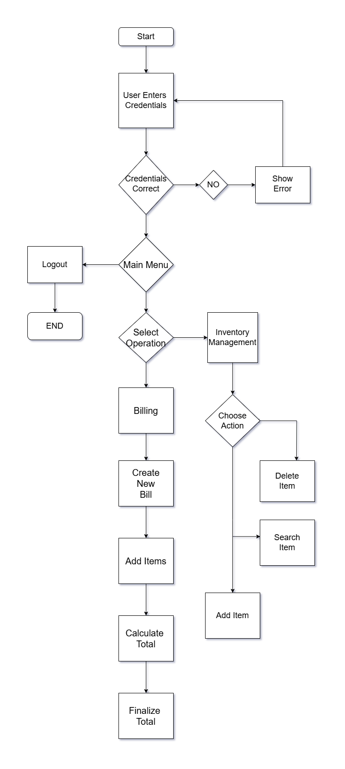
Flowchart

Slide 9
Testing & Validation
Unit testing
Integration Testing
System Testing
Manual Testing
Performace Testing
Verifies the functionality of individual components or methods.
Key Areas Tested:
Login verification.
Item Search.
Update Pricing & quantity.
Generate Bill.
Checks how well different components interact with each other.
Key Areas Tested:
DB Integration
GUI Flow
Input Validation
Functional Interactions
Error Handling
File Dependencies
Validates the entire system workflow to ensure it meets requirements.
Key Areas Tested:
Login Functionality
Item Search
Update Features
Billing
Error Handling
UI Flow
Systen was manually tested under various scenarios to identify issues.
Key Areas Tested:
Valid/Invalid credentials & error handling.
Button click, entry field & BG visuals.
Correct data retrieval & updates using existing, non-existing & out of stock items.
Ensures the system runs smoothly across different environments.
Key Areas Tested:
Load testing
Stress Testing
Scalability
Response Time
Endurance

Slide 10
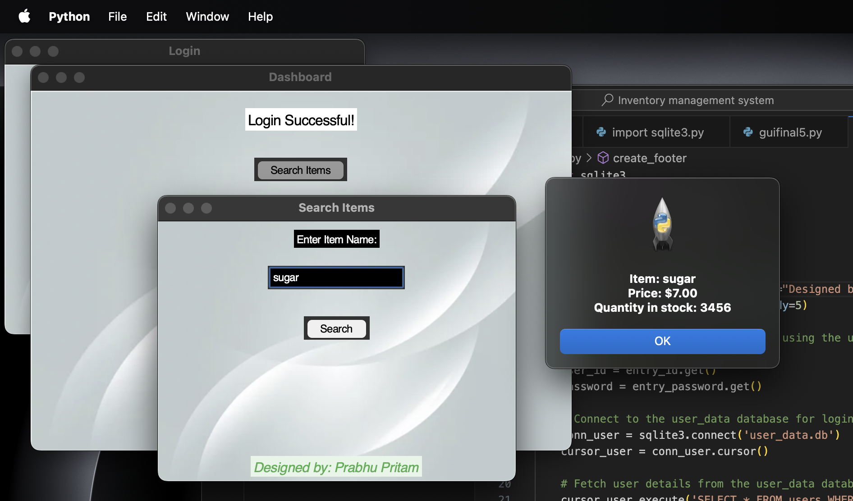
Conclusion
The project successfully implements an inventory and billing management system that is both functional and user-friendly, catering to real-world use cases.
A Tkinter-based GUI ensures an intuitive interface for user interaction, including features for login, inventory management, and billing operations.
SQLite is integrated for secure data storage and management, providing reliable support for user authentication and future inventory tracking.
Core functionalities include verifying user credentials, dynamically calculating and updating bills, and displaying itemized details in an organized manner.
The modular and scalable design allows for easy future enhancements, such as inventory persistence, reporting, and additional user roles.
The project effectively demonstrates the capability of Python for building efficient, practical solutions for inventory and billing challenges in small-scale businesses or individual use cases.

Slide 11

Limitations Of the Project
Basic Inventory Management: The system lacks persistent inventory tracking and storage in the database.
Limited User Roles: There is no differentiation of user roles (e.g., admin vs. cashier) or permissions.
Scalability Constraints: The reliance on SQLite limits scalability for larger applications with multiple users.
Static Design: The GUI is basic and may require redesign for better usability and aesthetics.

Slide 12
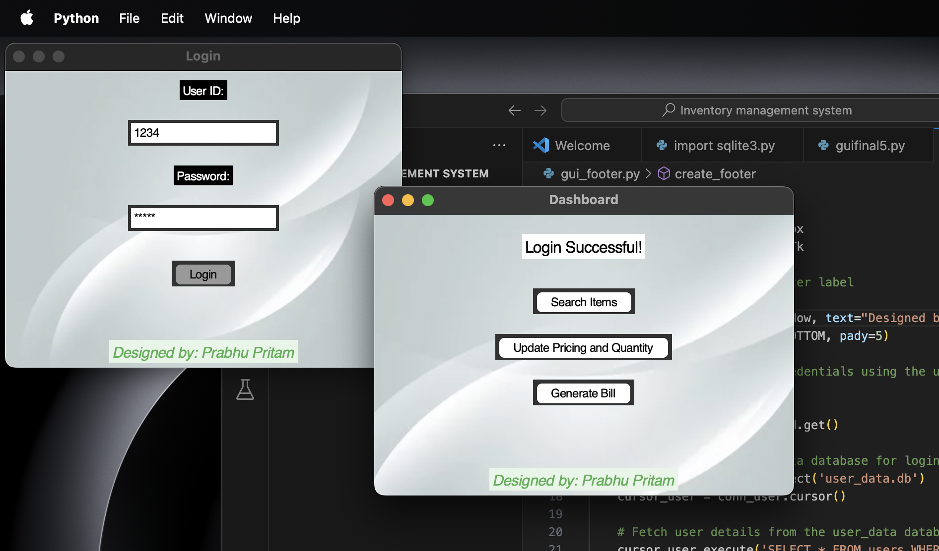
s
References
Python Official Documentation:
Python Software Foundation. (n.d.). Python documentation. Retrieved from https://docs.python.org/
2. Tkinter Documentation:
Tkinter. (n.d.). Tkinter 8.6 reference: a GUI for Python. Retrieved from https://docs.python.org/3/library/tkinter.html
3. SQLite Documentation:
SQLite. (n.d.). SQLite Documentation. Retrieved from https://www.sqlite.org/docs.html
4. Python SQLite3 Module Documentation:
Python Software Foundation. (n.d.). sqlite3 — DB-API 2.0 interface for SQLite databases. Retrieved from https://docs.python.org/3/library/sqlite3.html
5. Tkinter GUI Programming by Example:
Richard H. (2018). Tkinter GUI Programming by Example. Packt Publishing.

Slide 13
Thank you very much!

